Slide 1
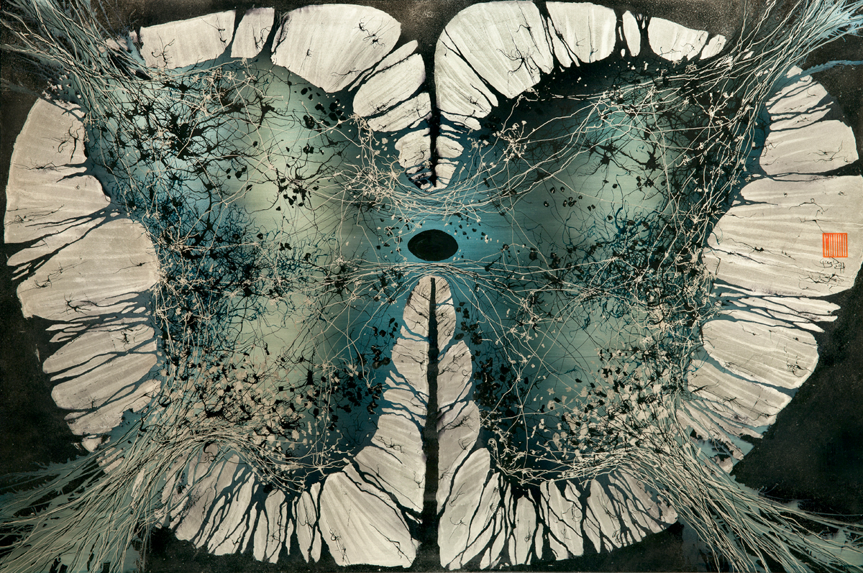
Lecture 11
The Spinal Cord and Pathways
Notes:
http://www.gregadunn.com/product/spinal-cord-print/

Slide 2
OVERVIEW
Control Centers – how do we control our bodies?
The Spinal Cord – what are the different parts of the spinal cord and how do they function?
Pathways – how do neurons travel through the nervous system?
The Peripheral Nervous System – how does the central nervous system communicate with the body?
Reflexes – how does the nervous system work to maintain homeostasis?

Slide 3
INTRODUCTION
Provides a pathway to and from the brain
Reflex center
Contains gray and white matter
Extends from the foramen magnum of the skull to the lumbar vertebrae
Notes:
3

Slide 4
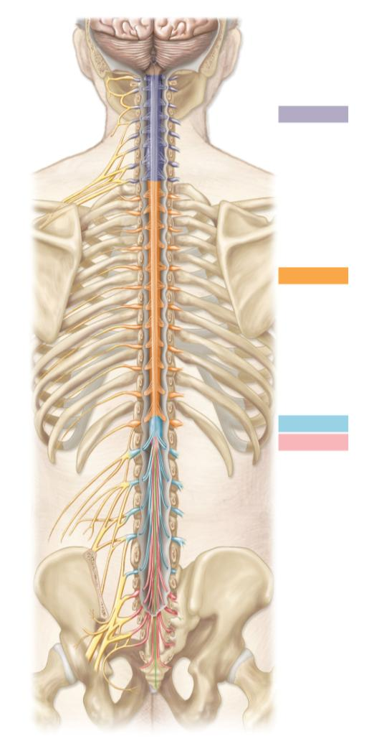
C1
Cervical plexus
C2
C3
Cervical part
C4
C5
Cervical enlargement
C6
C7
Brachial plexus
C8
T₁ vertebra
T1
T2
T3
T4
T5
Thoracic part
T6
T7
T8
T9
T10
Lumbosacral
enlargement
T11
L₁ vertebra
T12
Lumbar part
L1
Sacral part
Lumbar plexus
L2
L3
L4
Cauda equina
L5
Sacral plexus
S1
S2
S3
S4
S5

Slide 5
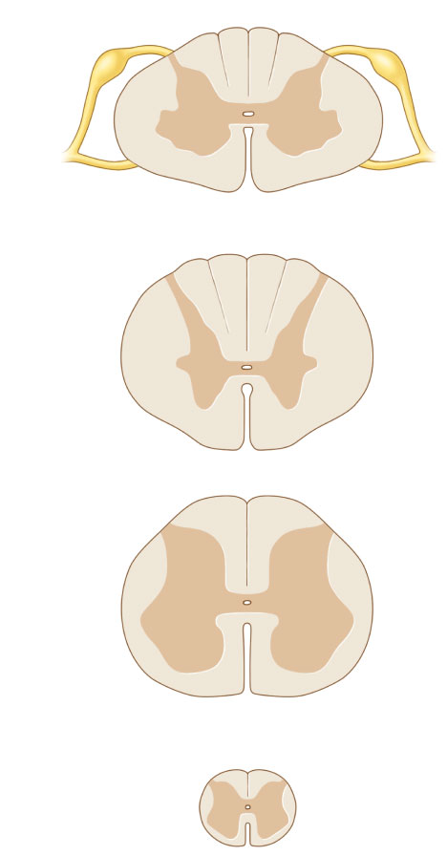
ANATOMY
Gray Horn
  Anterior, lateral, and posterior
  Contains neuron cell bodies and synapses
  On the inside
White Columns / Funiculi
  Anterior, lateral, and posterior
  Contains neuron axons
  On the outside
Posterior root contains sensory neurons
  Axons extend from their somas within the posterior root ganglion
Anterior root contains motor neurons
Posterior and anterior roots merge to form a single spinal nerve
Anterior fissure indicates the anterior surface
Central canal contains CSF
Posterior root
Posterior root
ganglion
White matter
Central
canal
Gray
matter
Spinal
nerve
Anterior
root
Anterior fissure
C₃
T₃
L₁
S₂
Notes:
5

Slide 6
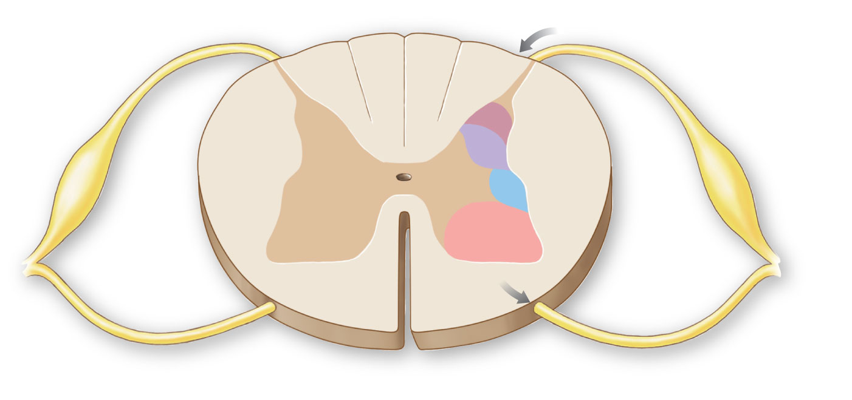
ANATOMY: GRAY MATTER
Anterior gray horn = Somatic motor somas and synapses
Lateral gray horn = Visceral motor somas and synapses
Posterior gray horn = Somatic or visceral sensory somas and synapses
From posterior root
Posterior
gray horn
Posterior
root
ganglion
Somatic
Sensory
cell bodies
Visceral
Lateral
gray horn
Visceral
Motor
cell bodies
Anterior
gray horn
Somatic
To anterior
root
Anterior median fissure
Notes:
6

Slide 7
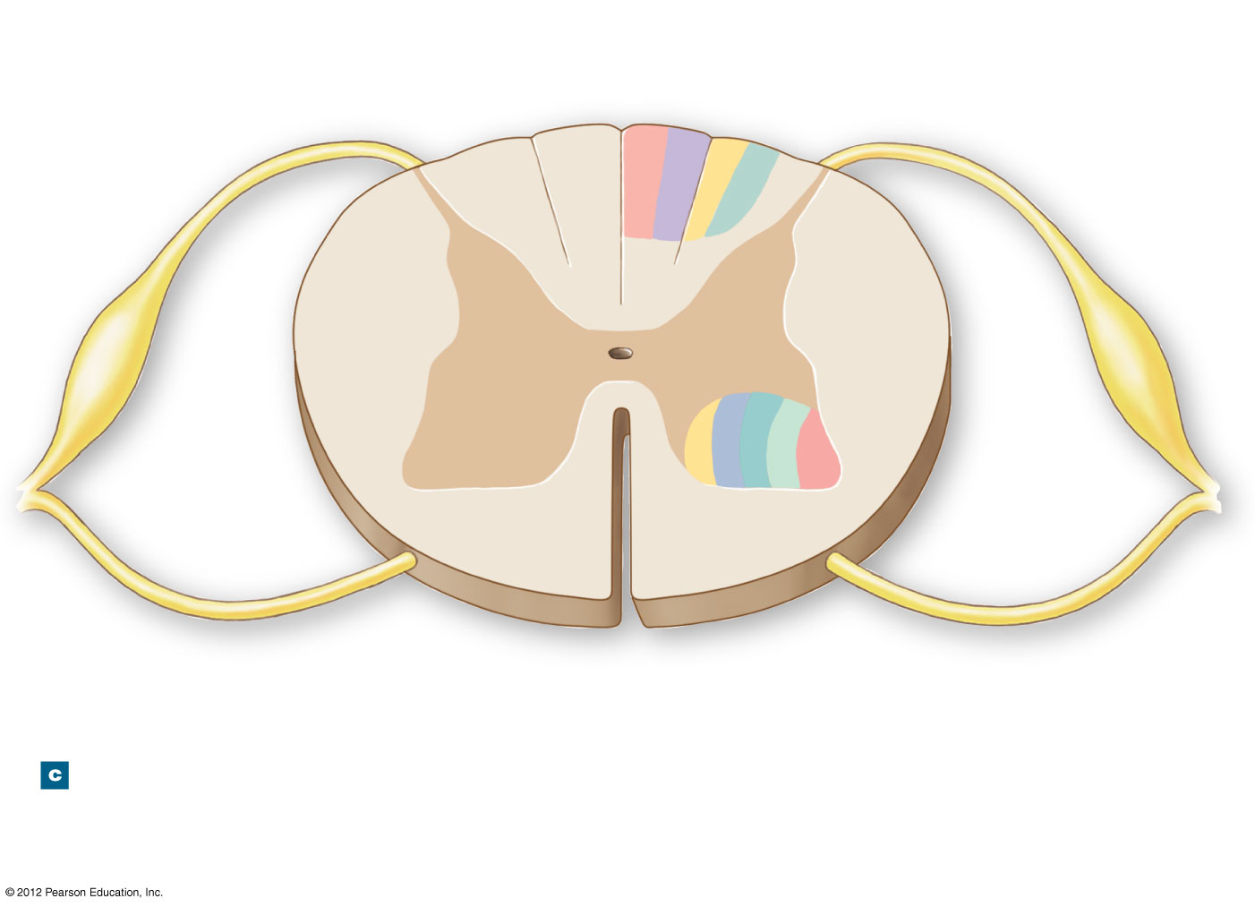
ANATOMY: WHITE MATTER
Posterior white columns = Somatic or visceral sensory axons
Anterior white columns = Somatic motor axons
Lateral white columns = Visceral motor axons
Posterior white column / funiculus
Lateral
white
column /
funiculus
Anterior white column / funiculus
Notes:
7

Slide 8
ANATOMY: WHITE MATTER
Anterior root = Contains all motor axons leaving the spinal cord
Posterior root = Contains all sensory axons entering the spinal cord
Posterior root
Anterior root
Notes:
8

Slide 9
ANATOMY: SOMATIC MOTOR
Somatic motor neurons = Anterior white columns (axons) + Anterior gray horn (somas)
Visceral motor neurons = Lateral white columns (axons) + Lateral gray horn (somas)
Sensory neurons = Posterior gray horn (somas) + Posterior white columns (axons)
Notes:
9

Slide 10
ANATOMY: VISCERAL MOTOR
Somatic motor neurons = Anterior white columns (axons) + Anterior gray horn (somas)
Visceral motor neurons = Lateral white columns (axons) + Lateral gray horn (somas)
Sensory neurons = Posterior gray horn (somas) + Posterior white columns (axons)
Notes:
10

Slide 11
ANATOMY: SENSORY
Somatic motor neurons = Anterior white columns (axons) + Anterior gray horn (somas)
Visceral motor neurons = Lateral white columns (axons) + Lateral gray horn (somas)
Sensory neurons = Posterior gray horn (somas) + Posterior white columns (axons)
Notes:
11

Slide 12
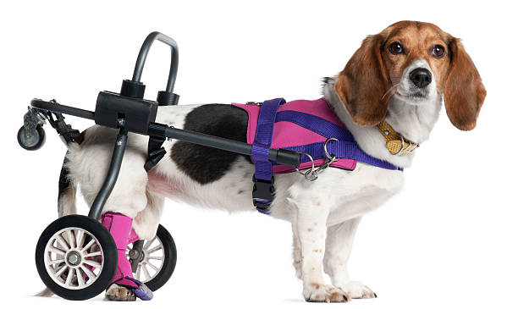
ANATOMY: INJURIES
The more superior the spinal cord injury, the worse the prognosis
  Due to the anatomy of white columns
Paraplegia = Inferior injuries only affect the legs
Quadriplegia = Superior injuries affect the arms and legs
  ALL white columns travel through the neck, even those going to the legs
Injuries of the upper neck will affect respiration

Slide 13
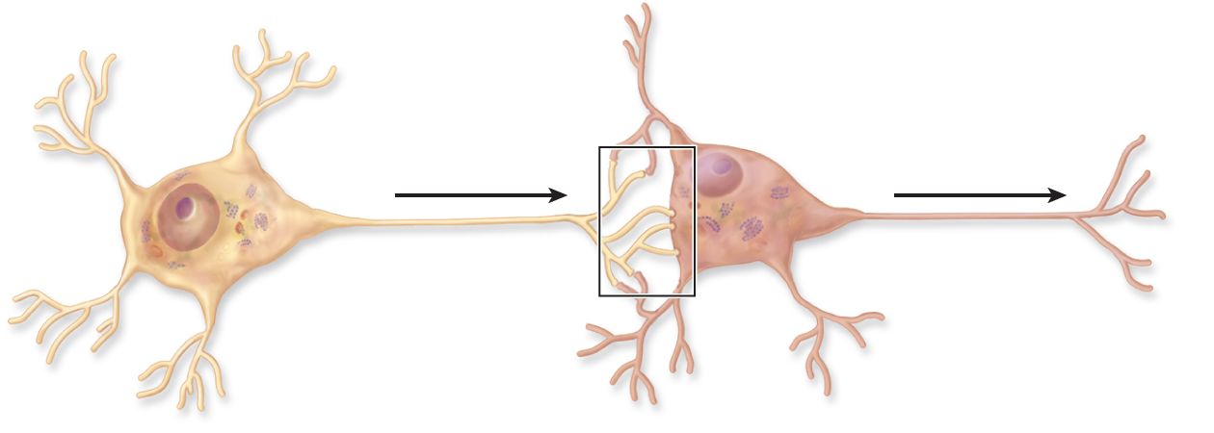
ANATOMY: GANGLIA
Ganglia = ”Islands” of gray matter within the white matter of a nerve
  Somas and synapses in an environment of mostly axons
  Like basal nuclei in the cerebrum and nuclei in the brainstem
Like all gray matter, a ganglion is a location where neurons may transfer their impulses to another neuron
  Axon of neuron #1 → synapse → dendrites of neuron #2 → cell body of neuron #2 → axon of neuron #2

Slide 14
ANATOMY: GANGLIA
Posterior Root Ganglion contains somas of unipolar neurons
  Synapse with somas in posterior gray horn
Visceral Motor Ganglia are outside the CNS
Posterior
root
ganglion
Somatic
Sensory
cell bodies
Visceral
Visceral
Motor
cell bodies
Somatic
Notes:
14

Slide 15
ANATOMY: GANGLIA
Ganglia = ”Islands” of gray matter within the white matter of a nerve
Posterior Root Ganglion contains somas of unipolar neurons
  Synapse with somas in posterior gray horn
Visceral Motor Ganglia are outside the CNS

Slide 16
NERVES
Nerves = Bundles of axons carrying information to or from the same location outside the CNS
  Make up the Peripheral Nervous System (PNS)
3 Types of Nerves
  Sensory nerves: Contain ONLY sensory axons
    Body → CNS
  Motor nerves: Contain ONLY motor axons
    CNS → Body
  Mixed nerves: Contain both sensory AND motor axons
    Most common type of nerve
Notes:
16

Slide 17
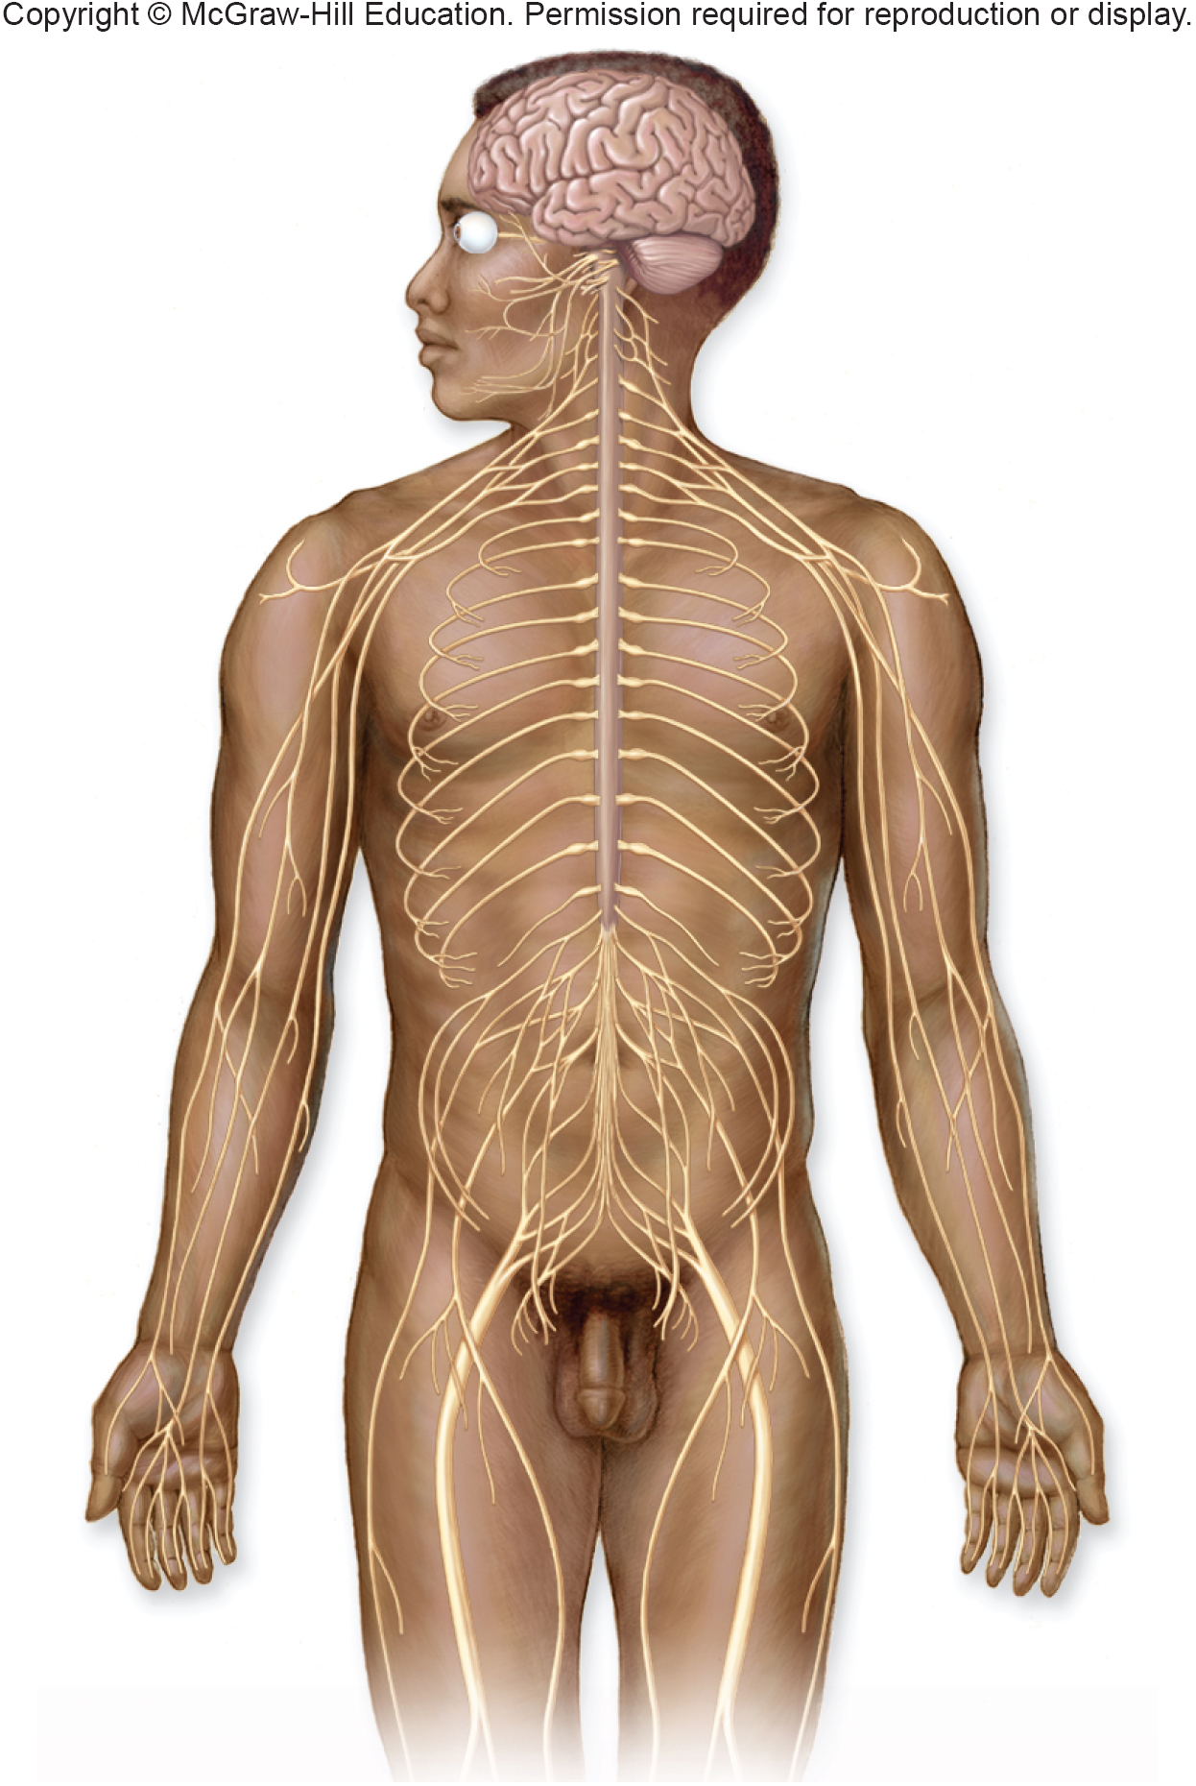
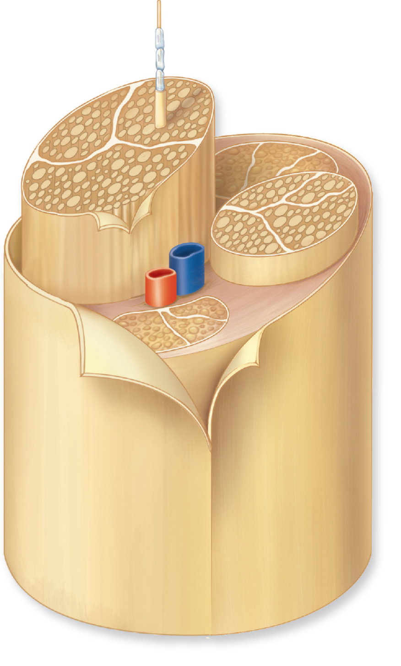
NERVES

Slide 18
NERVES
Mixed nerve: Contains both sensory and motor axons

Slide 19
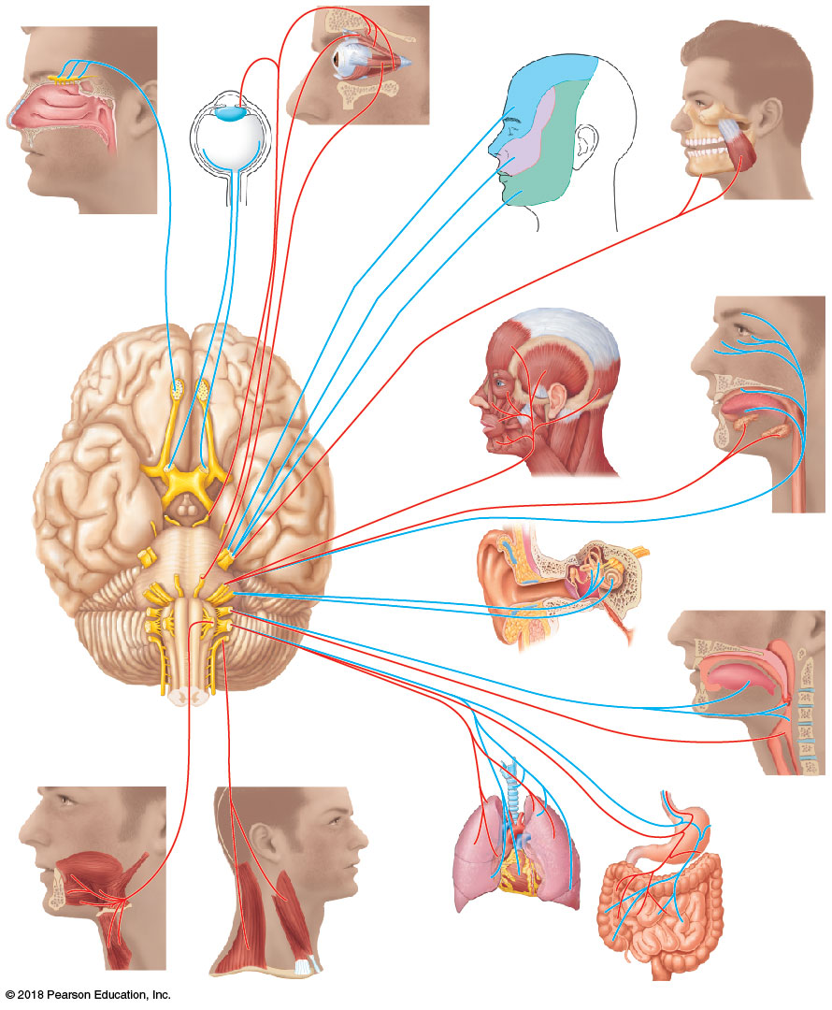
NERVES: CRANIAL NERVES
12 pairs of cranial nerves
  Come off the brainstem
Some are entirely sensory
  I: Olfactory
  II: Optic
  VIII: Vestibulocochlear
Some are entirely motor
  III: Oculomotor
  IV: Trochlear
  VI: Abducens
  XI: Accessory
  XII: Hypoglossal
Some are mixed
  V: Trigeminal
  VII: Facial
  IX: Glossopharyngeal
  X: Vagus
Branch to serve the head and neck
III Oculomotor
IV Trochlear
I Olfactory
VI Abducens
II Optic
V Trigeminal
V Trigeminal
VII Facial
Vestibular
branch
Cochlear
branch
VIII Vestibulocochlear
X Vagus
XII Hypoglossal
XI Accessory
IX Glossopharyngeal

Slide 20

NERVES: CRANIAL NERVES
Speech
Music

Slide 21
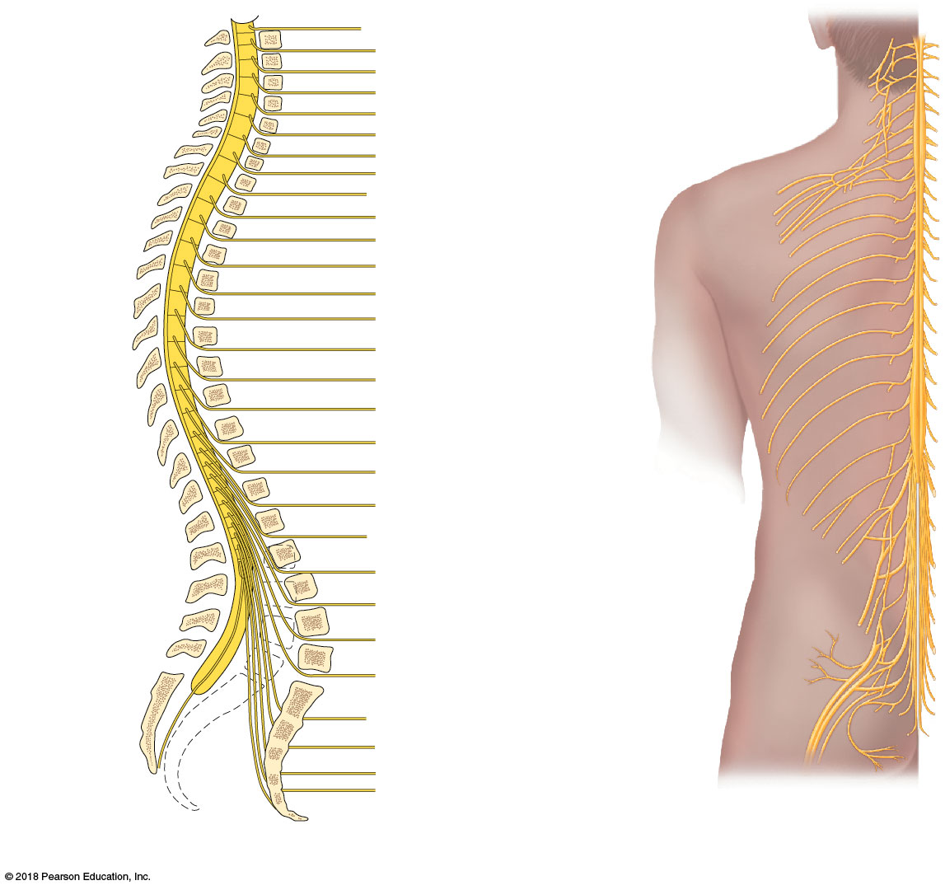
NERVES: SPINAL NERVES
31 pairs of spinal nerves
  8 cervical
  12 thoracic
  5 lumbar
  5 sacral
  1 coccygeal
All are mixed
Branch to form most nerves in the body
C₁
2
Cervical
nerves
3
4
5
6
7
Ventral rami form
brachial plexus
(C₅ – C₈; T₁)
T₁
8*
2
3
4
Thoracic
nerves
5
6
7
8
9
10
Lumbar
nerves
11
12
Sacral
nerves
L₁
2
3
Ventral rami form
lumbar plexus
(L₁ – L₄)
4
5
S₁
2
3
4

Slide 22
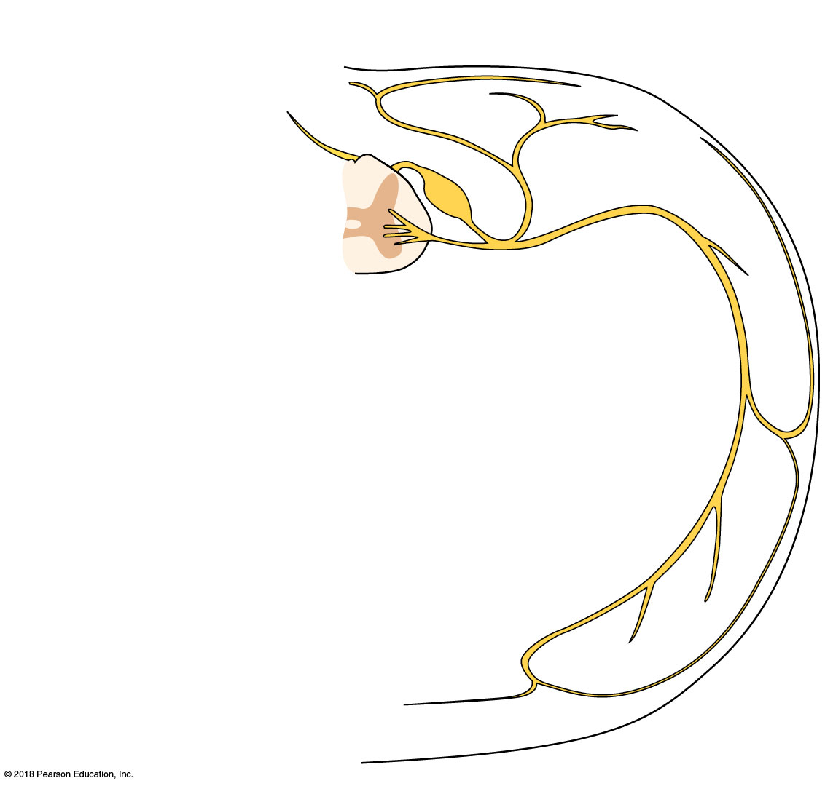
Posterior root
Posterior
ramus
Posterior root
ganglion
Spinal
cord
Anterior
ramus
Anterior
root
Nerve
RAMI = ROOTS

Slide 23
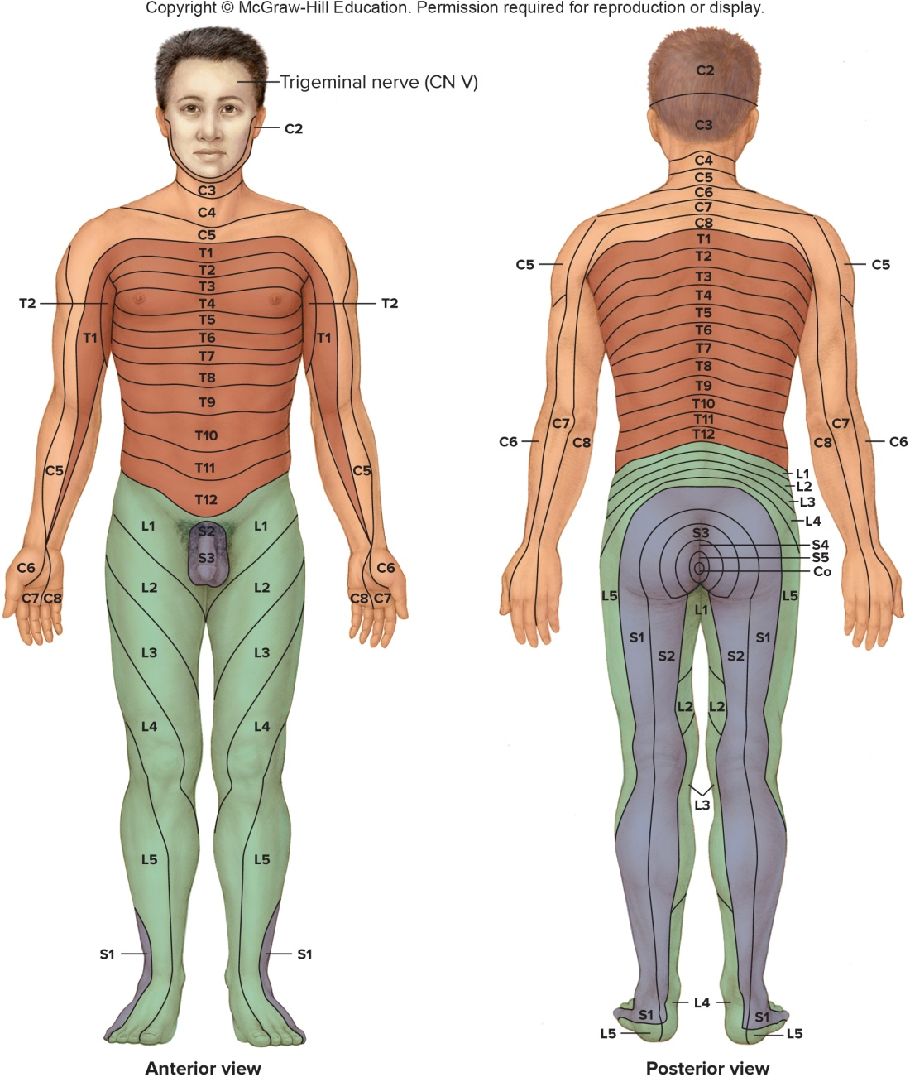
NERVES: SPINAL NERVES
Dermatomes
  Each pair of spinal nerves monitors sensation for specific surface areas
Notes:
23

Slide 24
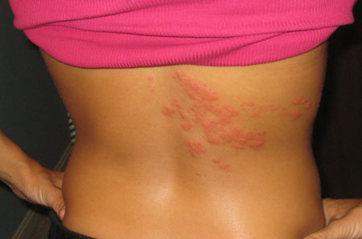
WHY DOES THIS MATTER?
Varicella zoster virus (Chicken Pox) lies dormant in posterior root ganglia
Recrudescence → SHINGLES

Slide 25
Thalamus (gray matter)
CEREBRUM
Cerebral cortex (gray matter)
Cerebellum
BRAINSTEM
Medulla Oblongata
Gray matter of spinal cord (inside)
Posterior root ganglion
White matter of spinal cord (outside)
Posterior root
Spinal nerve
Spinal nerve
Anterior root
SPINAL CORD

Slide 26
ANATOMY SUMMARY
SENSORY (Somatic and Visceral): Body → CNS
  Ascending pathway – neurons travel superiorly
  3 “Steps”
    1st order neuron = Unipolar
    2nd order neuron = Multipolar
    3rd order neuron = Multipolar
  Pathway
    Receptor
    Spinal nerve
    Posterior root
    Posterior root ganglion
    Posterior gray horn (spinal cord)
    Posterior white column (spinal cord)
    Cross over at Medulla Oblongata (brainstem)
    Thalamus (diencephalon)
    Primary somatosensory cerebral cortex (brain)
Neurons synapse in the spinal cord before going to the brain
Notes:
26

Slide 27
Third order neuron
Second order neuron
First order neuron
R

Slide 28
ANATOMY SUMMARY
MOTOR (Somatic): CNS → Body
  Descending pathway – neurons travel inferiorly
  2 “Steps”
    1st order neuron = Multipolar
    2nd order neuron = Multipolar
  Pathway
    Primary motor cortex (brain)
    +/- Basal Nuclei and Cerebellum
    Cross over at Medulla Oblongata (brainstem)
    Anterior white column (spinal cord)
    Anterior gray horn (spinal cord)
    Anterior root (spinal cord)
    Spinal nerve
    Skeletal muscle
Neurons synapse in the spinal cord before going to the body
Notes:
28

Slide 29
First order neuron
Second order neuron
E

Slide 30
AUTONOMIC NERVOUS SYSTEM
Somatic Motor
  Involves 2 motor neurons
    1st order neuron: Cerebrum → Spinal cord
    2nd order neuron: Spinal cord → Skeletal muscle
  Does NOT involve ganglia
Visceral Motor (aka Autonomic Nervous System)
  Involves 3 motor neurons
    1st order neuron: Nuclei in brainstem → Spinal cord
    2nd order neuron: Spinal cord → Ganglia
    3rd order neuron: Ganglia → Internal organ
  Involves ganglia outside the CNS
  2 Divisions
    Sympathetic division
    Parasympathetic division

Slide 31
AUTONOMIC NERVOUS SYSTEM
Visceral Motor System = Autonomic Nervous System (ANS)
  Controls all activity outside conscious control
2 Divisions of the ANS
  Sympathetic division
    “On-switch”
    Known as the “fight or flight” system
  Parasympathetic division
    ”Off-switch”
    Known as the “rest and digest” system
Notes:
31

Slide 32
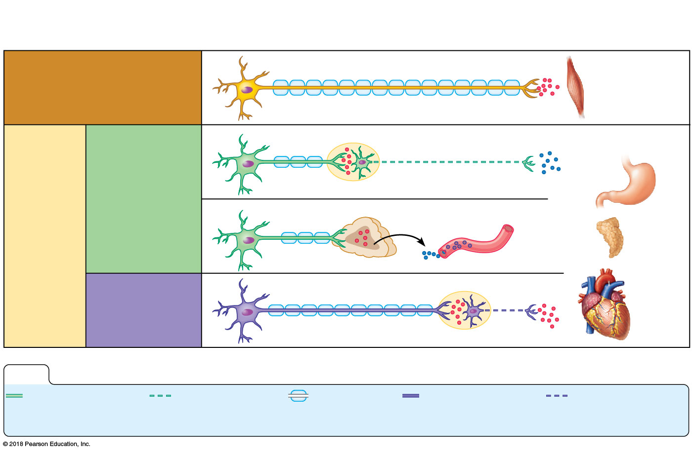
AUTONOMIC NERVOUS SYSTEM
Central
nervous system
Peripheral nervous system
Effector organs
Somatic nervous system
Skeletal muscle
Smooth muscle
(e.g., in stomach)
Sympathetic
division
Ganglion
Autonomic
nervous
system
Blood
vessel
Glands
Parasympathetic
division
Cardiac
muscle
Ganglion
KEY:
Preganglionic
axons
(sympathetic)
Postganglionic
axons
(sympathetic)
Myelination
Preganglionic
axons
(parasympathetic)
Postganglionic
axons
(parasympathetic)

Slide 33
ANATOMY SUMMARY
MOTOR (Visceral): CNS → Body
  Descending pathway – neurons travel inferiorly
  3 “Steps”
    1st order neuron = Multipolar
    2nd order neuron (pre-ganglionic) = Multipolar
    2nd order neuron (post-ganglionic) = Multipolar
  Pathway
    Nuclei in pons or medulla oblongata (brain)
    Lateral white column (spinal cord)
    Lateral gray horn (spinal cord)
    Anterior root (spinal cord)
    Spinal nerve
    Ganglion
    Organ
Visceral motor neurons synapse again outside the CNS before going to the organs
Notes:
33

Slide 34
First order neuron
Second order neuron
Pre-ganglionic
Third order neuron
Post-ganglionic
E

Slide 35
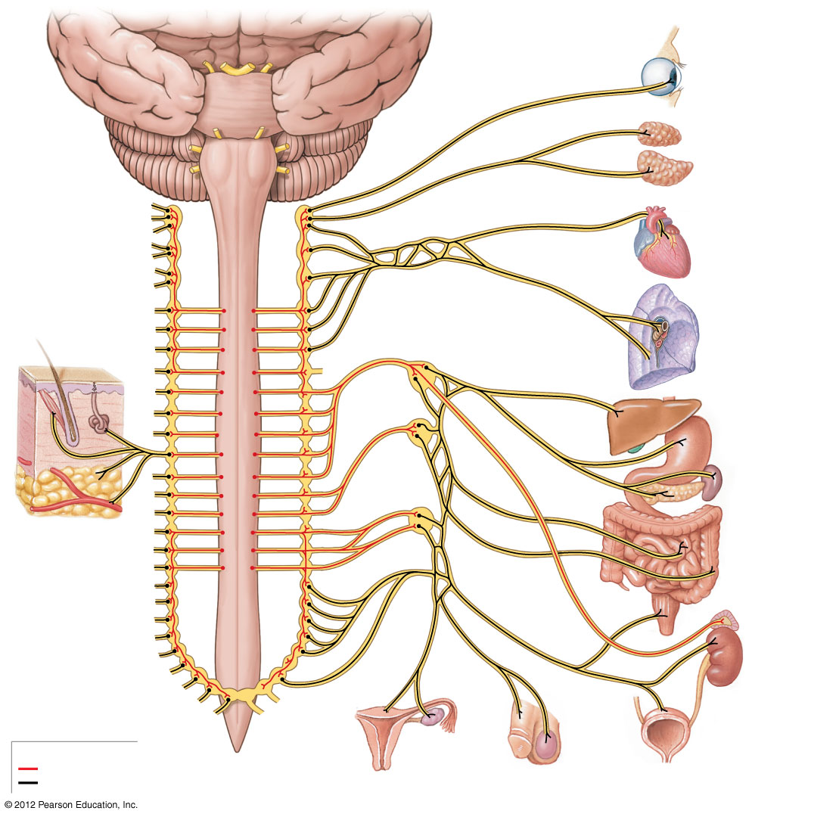
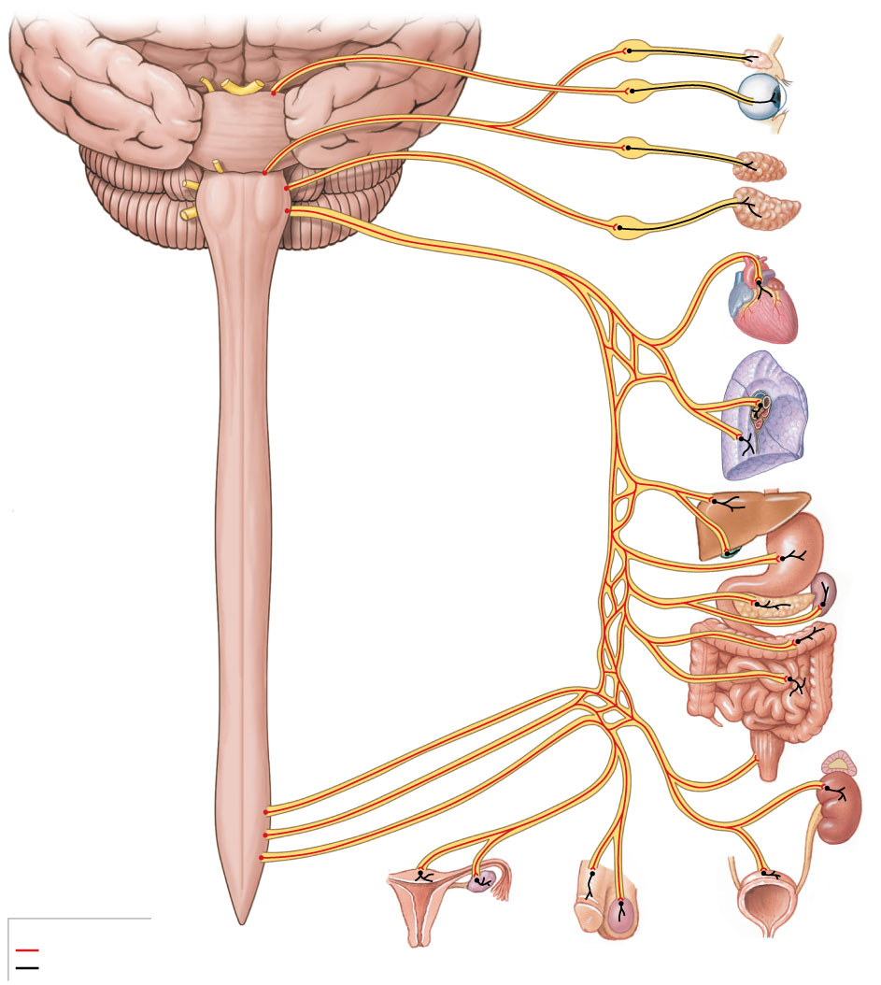
AUTONOMIC NERVOUS SYSTEM
Sympathetic
Parasympathetic

Slide 36
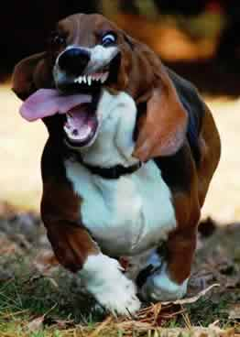
AUTONOMIC NERVOUS SYSTEM
Sympathetic Division
  Fight or Flight – STIMULATE
  Neurotransmitter = Norepinephrine
    Mimics adrenaline
  Effects
    Pupil dilation
    Decreased smooth muscle activity of the digestive system
    Relaxation of the urinary bladder
    Dilation of respiratory passages
    Increased heart rate
Notes:
36

Slide 37

WHY DOES THIS MATTER?
Anxiety is a disease of the sympathetic nervous system

Slide 38

AUTONOMIC NERVOUS SYSTEM
Parasympathetic Division
  Rest and Digest – Energy storage
  Neurotransmitter = Acetylcholine
    Relaxation, contraction of digestive muscles
  Effects
    Pupil constriction
    Increased smooth muscle activity of the digestive system
    Contraction of the urinary bladder
    Constriction of respiratory passages
    Reduced heart rate
Notes:
38

Slide 39
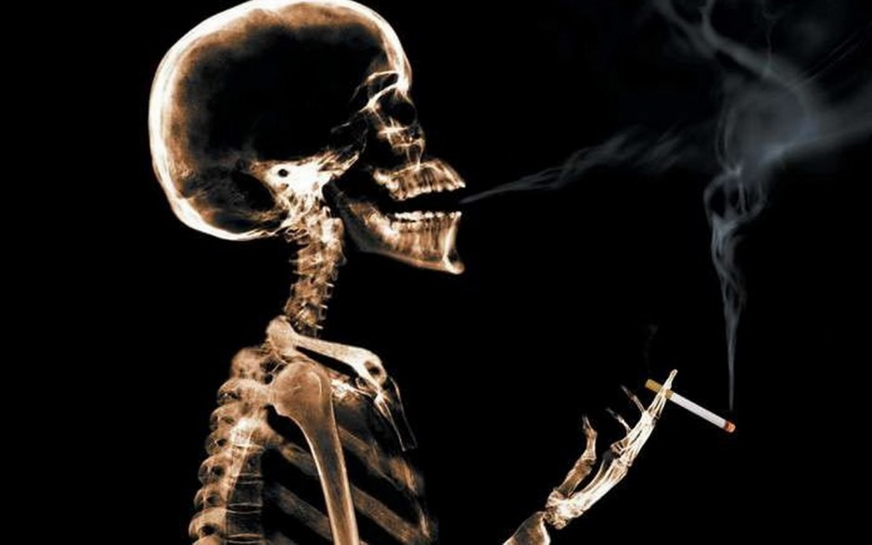
WHY DOES THIS MATTER?
Nicotine mimics the relaxing effects of the parasympathetic nervous system

Slide 40
AUTONOMIC NERVOUS SYSTEM
Tropicamide is an eye drop administered to dilate the pupil, which allows an ophthalmologist to thoroughly examine the back of the eye.
Which autonomic division does tropicamide mimic?
SYMPATHETIC
PARASYMPATHETIC

Slide 41
AUTONOMIC NERVOUS SYSTEM
People with asthma are often treated with a class of medications called α₂-blockers.
Given what you know about the autonomic nervous system, which division do α₂-blockers block?
SYMPATHETIC
PARASYMPATHETIC

Slide 42
PLEXUSES
Plexus = A network of nerves serving motor and sensory needs of the limbs
Form from ventral rami of spinal nerves in the cervical, lumbar, and sacral regions
3 Plexuses
  Brachial – Innervate the arm
  Lumbar – Innervate the anterior leg
  Sacral – Innervate the posterior leg

Slide 43
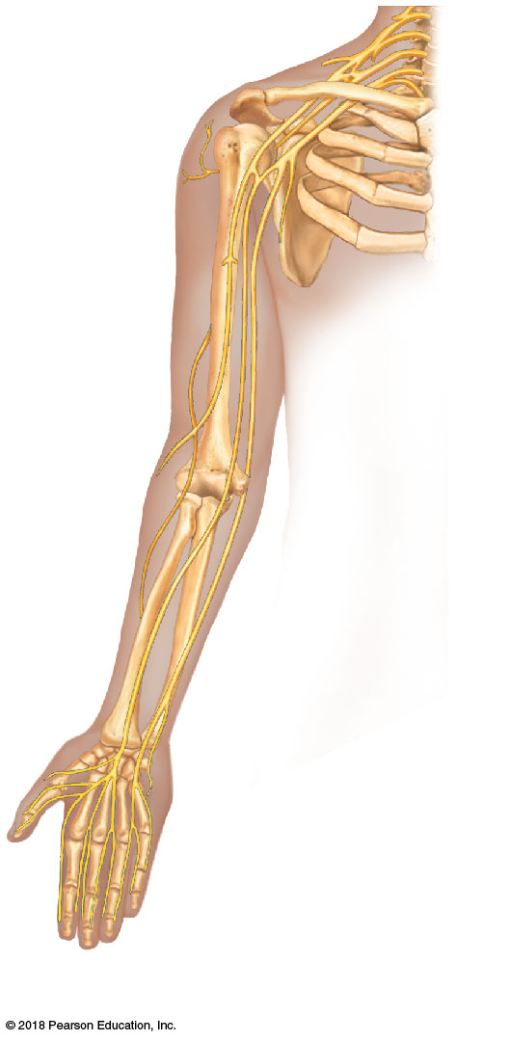
PLEXUSES: BRACHIAL
Axillary nerve
Axillary nerve = Shoulder movement; skin of shoulder
  Muscles = Deltoid
Radial nerve = Extends elbow, wrist, and digits; skin of posterior arm
  Muscles = Triceps brachii, Extensor digitorum
Musculocutaneous nerve = Flexes elbow; skin of the lateral forarm
  Muscles = Biceps brachii
Median nerve = Flexes wrist, skin of forearm and lateral hand (thumb)
Ulnar nerve = Flexes wrist and digits; skin of the medial hand
Humerus
Radial
nerve
Musculo-
cutaneous
nerve
Ulna
Radius
Ulnar nerve
Median
nerve

Slide 44
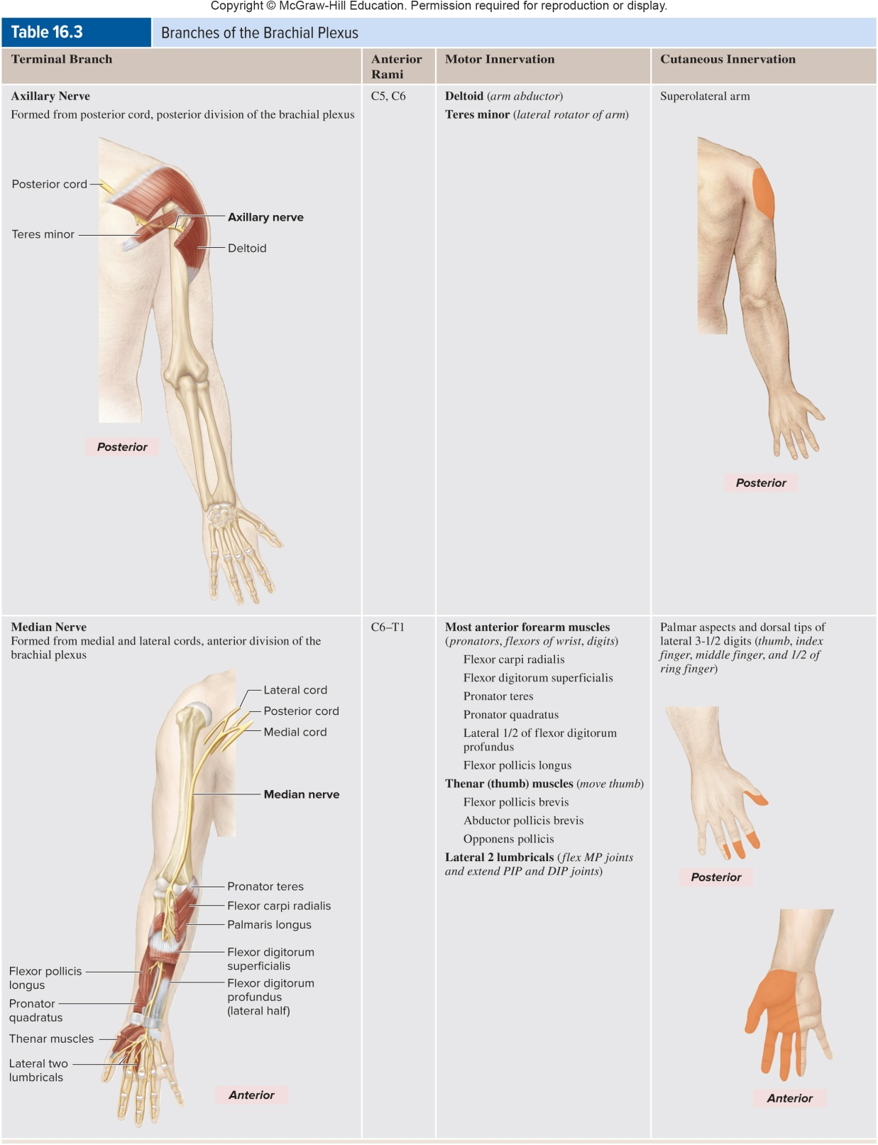
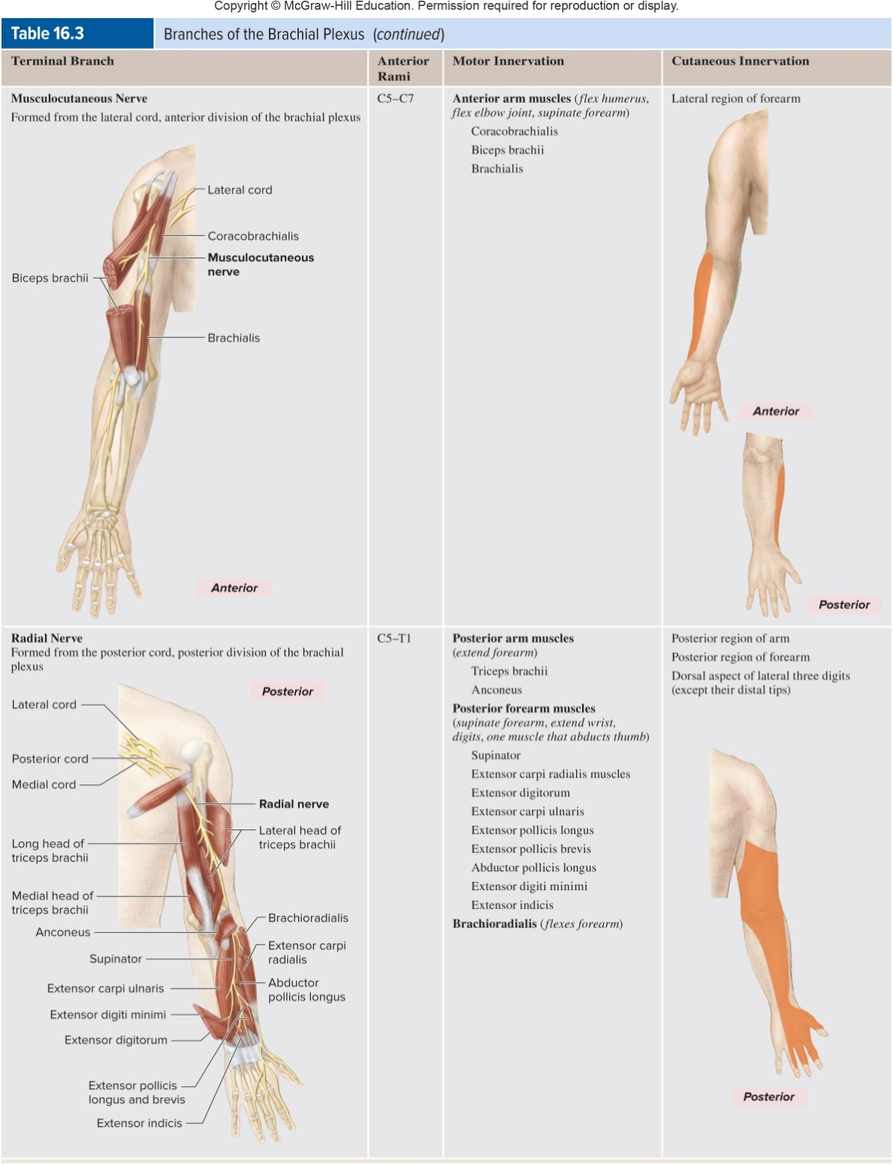
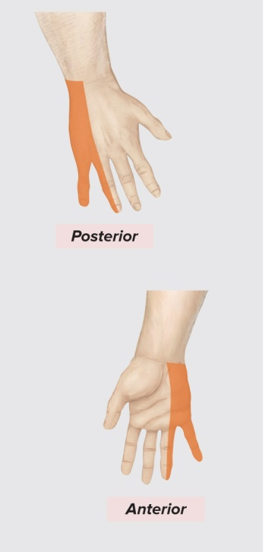
PLEXUSES: BRACHIAL
Axillary
Radial
Musculo-cutaneous
Median
Ulnar

Slide 45
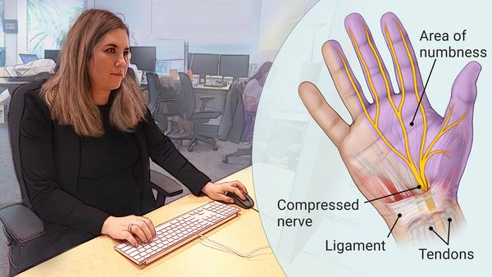
WHY DOES THIS MATTER?
What nerve is affected by carpal tunnel syndrome?

Slide 46
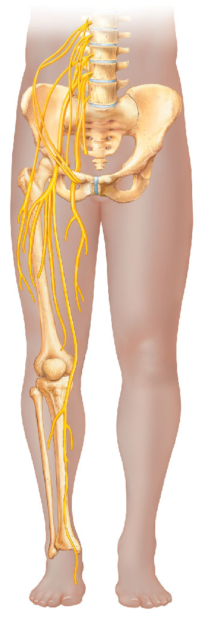
PLEXUSES: LUMBAR
Femoral nerve = Flexes hip, extends knee; skin of anterior leg
  Muscles = Quadriceps muscles
Obturator nerve = Adduct thigh; skin of medial leg
  Muscles = Adductor muscles
Femoral nerve
Obturator nerve
Femur

Slide 47
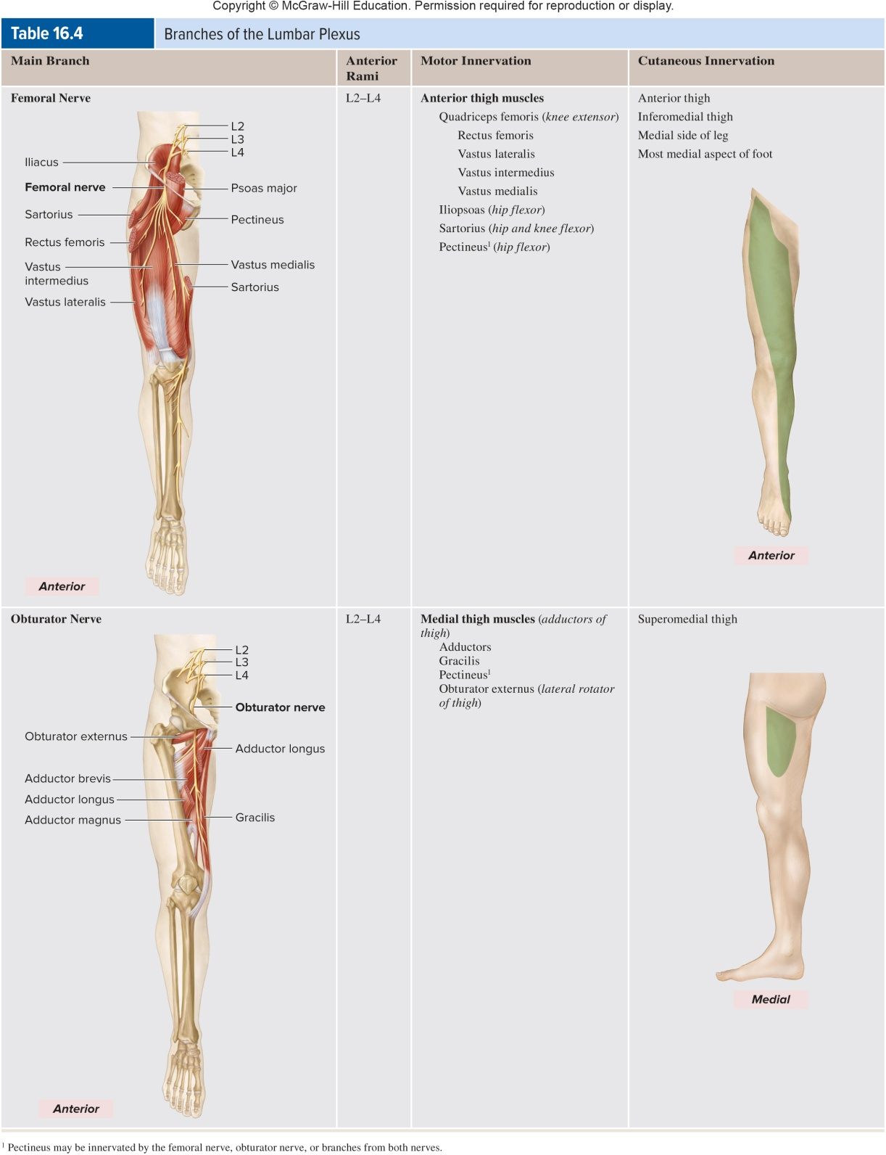
PLEXUSES: LUMBAR
Femoral
Obturator

Slide 48
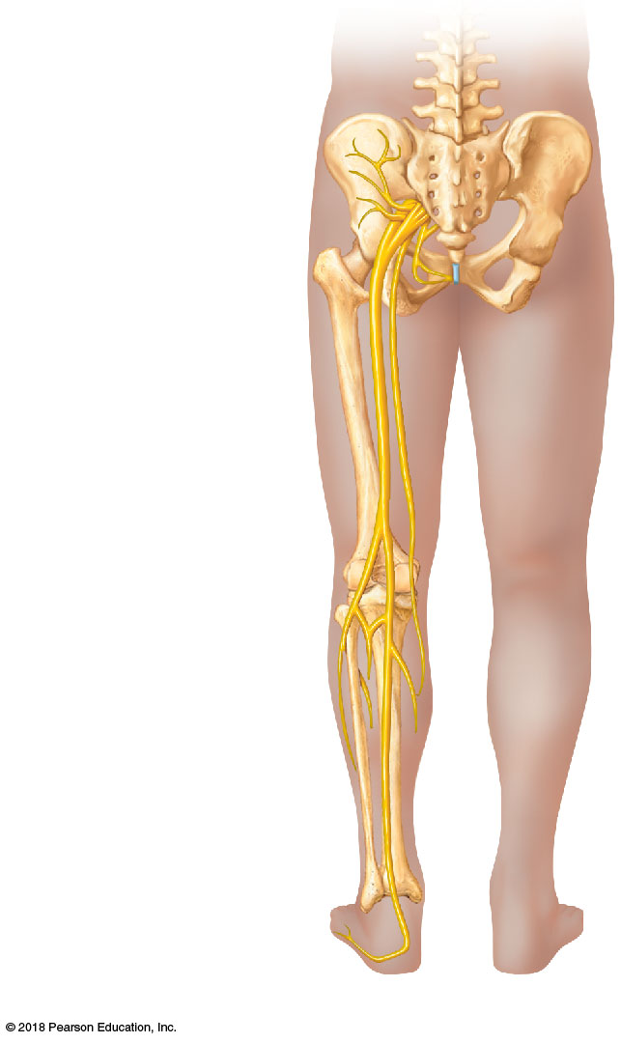
PLEXUSES: SACRAL
Sciatic nerve = Extends hip, flexes knee; skin of lateral and posterior thigh
  Muscles = Biceps femoris
Superior and inferior gluteal nerves = Extend hip and abduct hip
  Muscles = Gluteal muscles
Superior gluteal
nerve
Inferior gluteal
nerve
Sciatic nerve

Slide 49
REFLEXES
Reflexes are rapid, predictable, and involuntary responses to stimuli initiated by the spinal cord
5 Elements of a Reflex
  Sensory receptor: Reacts to a stimulus
  Sensory neuron: Carries message to the integration center
  Integration center: Entirely within the spinal cord, processes information and directs motor output
  Motor neuron: Carries message to an effector
  Effector organ: The muscle or gland to be stimulated

Slide 50
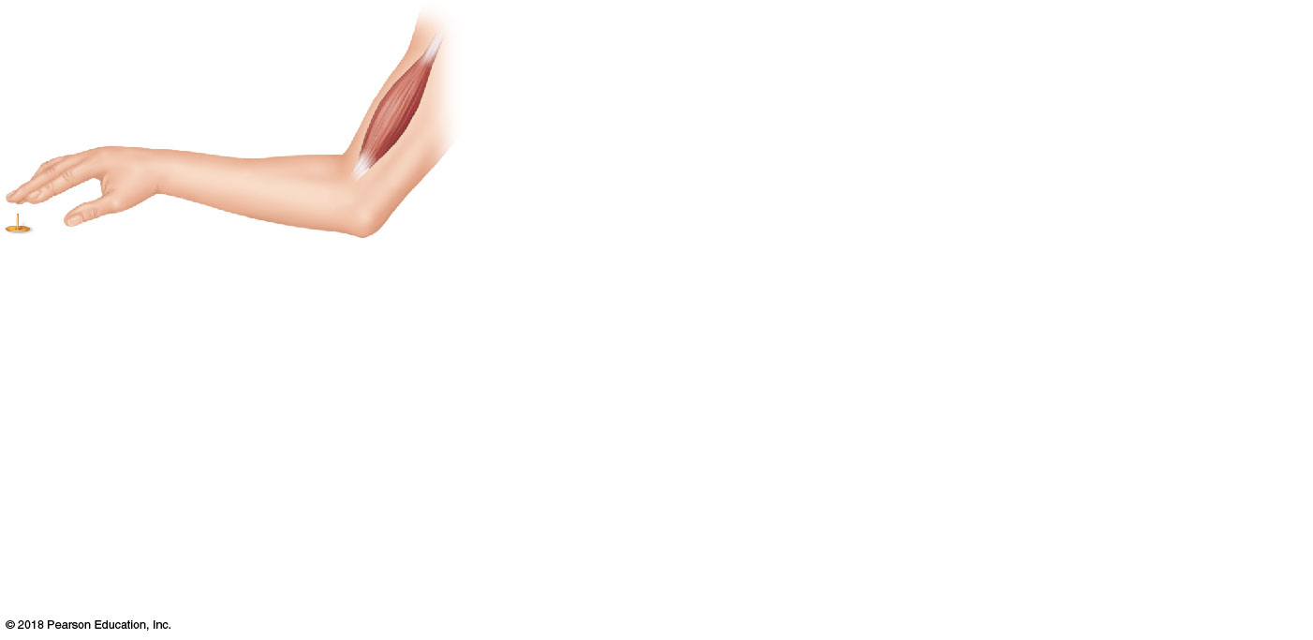
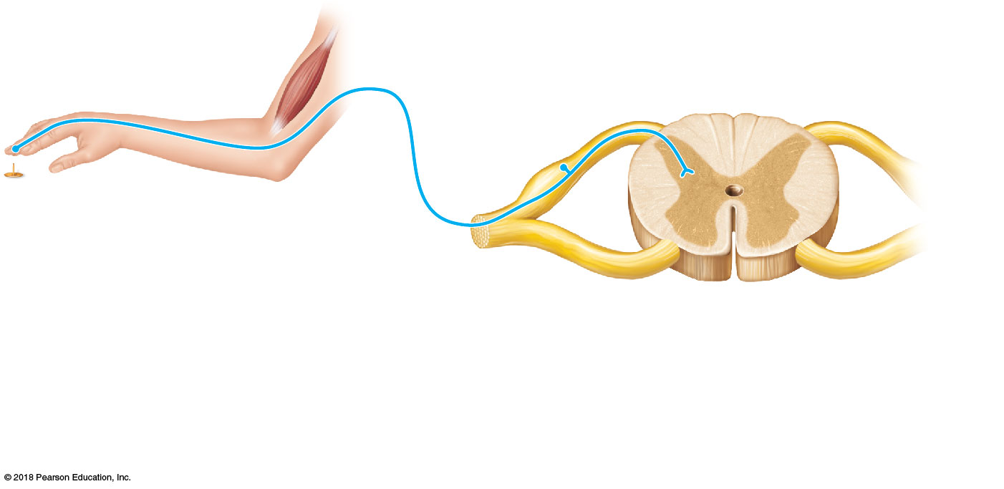

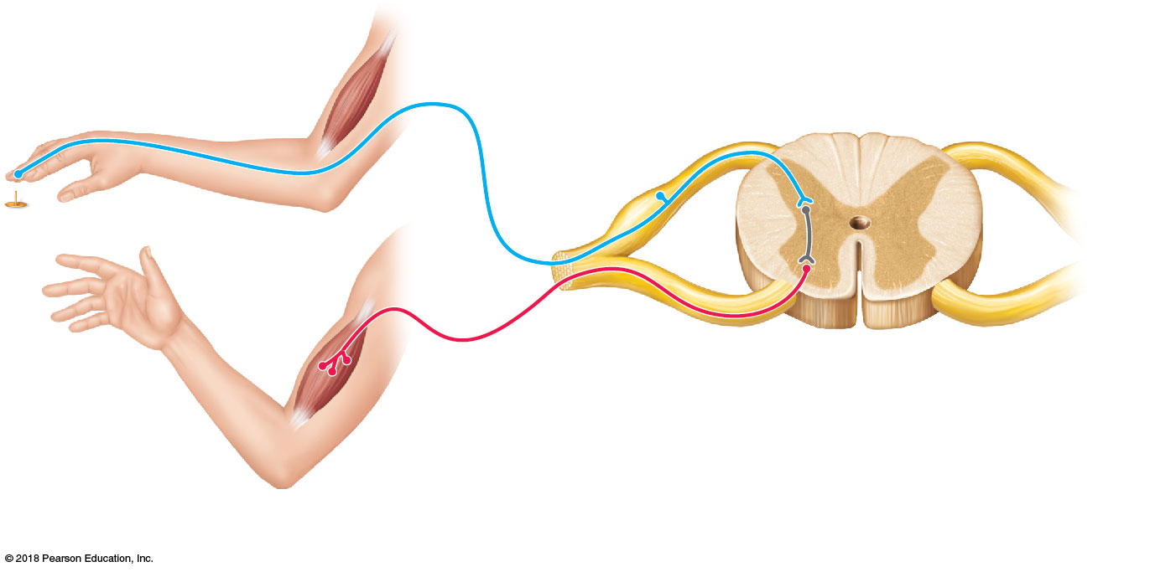
REFLEXES
1
Sensory receptor
2
Sensory (afferent) neuron
3
Interneuron
4
Motor (efferent) neuron
5
Effector organ

Slide 51
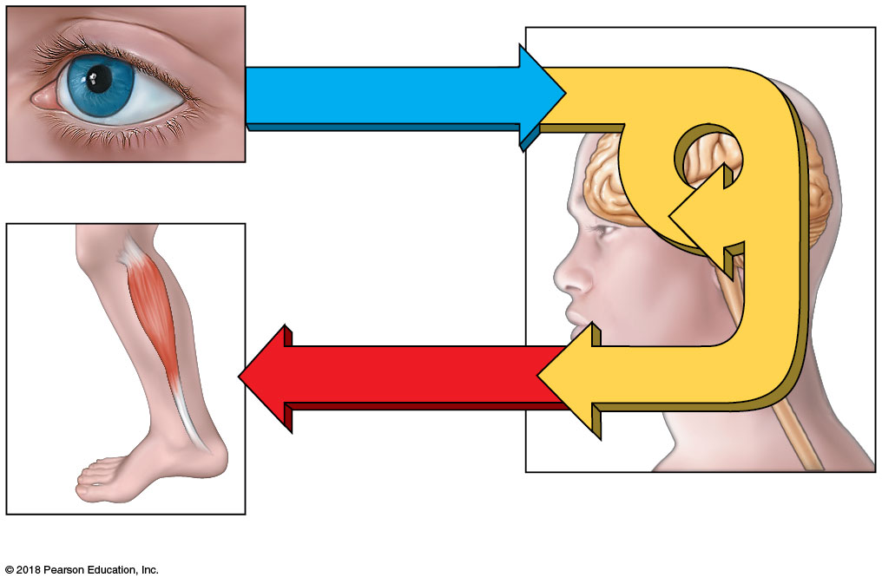
REFLEXES
Sensory input
Integration
Integration
Sensory receptor
Motor output
Brain and spinal cord
Effector
Reflexes maintain homeostasis

